Slide 1
Machine Learning Classifiers
UNIT-II

Slide 2
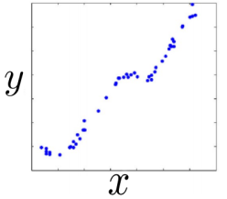
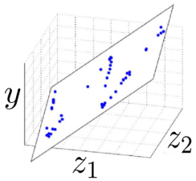
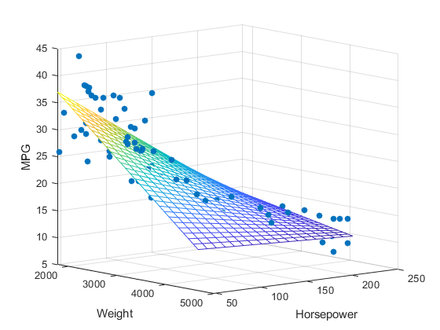


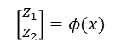
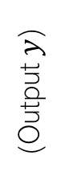
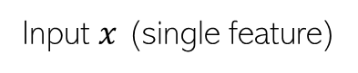
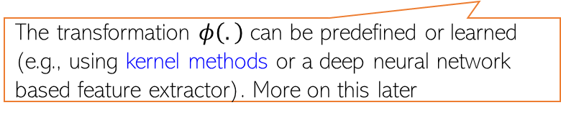
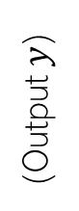
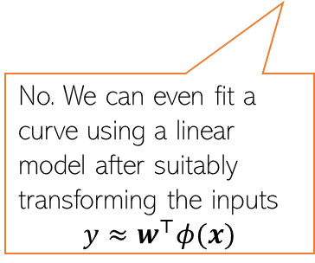
Linear Regression: Pictorially
2
Linear regression is like fitting a line or (hyper)plane to a set of points
The line/plane must also predict outputs the unseen (test) inputs well
$$\left[\begin{aligned}z_{1} \\ z_{2}\end{aligned}\right]=φ(x)$$
What if a line/plane doesn’t model the input-output relationship very well, e.g., if their relationship is better modeled by a nonlinear curve or curved surface?
Original (single) feature
Nonlinear curve needed
Two features
Can fit a plane (linear)
(Output $y$)
(Output $y$)
Do linear models become useless in such cases?
No. We can even fit a curve using a linear model after suitably transforming the inputs
$$y≈w^{⊤}φ(x)$$
Input $x$ (single feature)
(Feature 2)
(Feature 1)
The transformation $φ\left(.\right)$ can be predefined or learned (e.g., using kernel methods or a deep neural network based feature extractor). More on this later

Slide 3
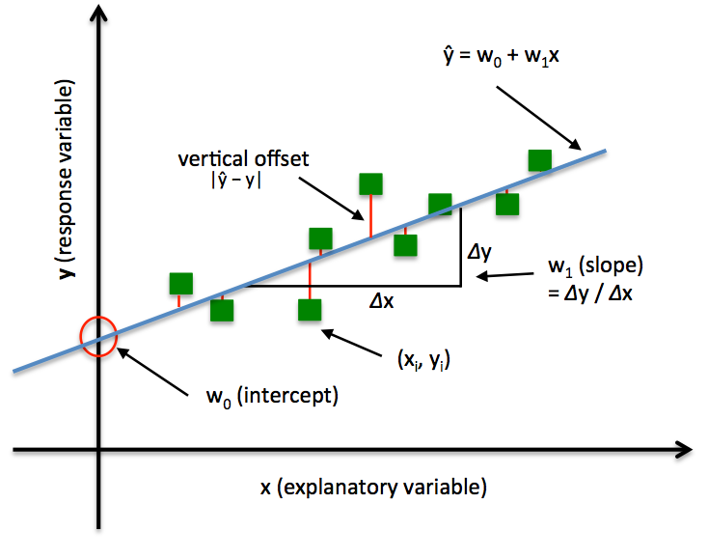
Simplest Possible Linear Regression Model
This is the base model for all statistical machine learning
x is a one feature data variable
y is the value we are trying to predict
The regression model is
Two parameters to estimate – the slope of the line w₁ and the y-intercept w₀
ε is the unexplained, random, or error component.
Notes:
3

Slide 4
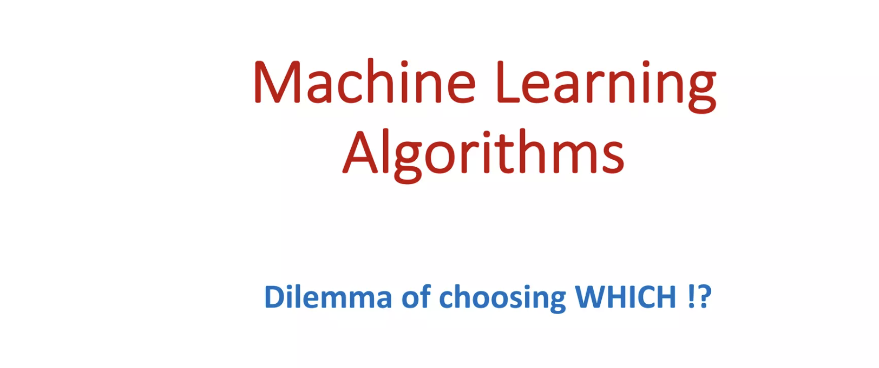

Slide 5
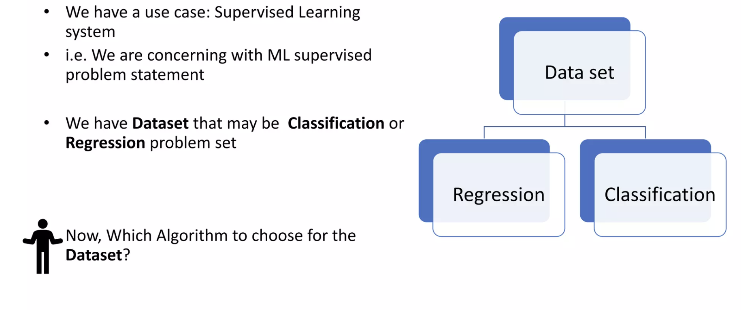

Slide 6
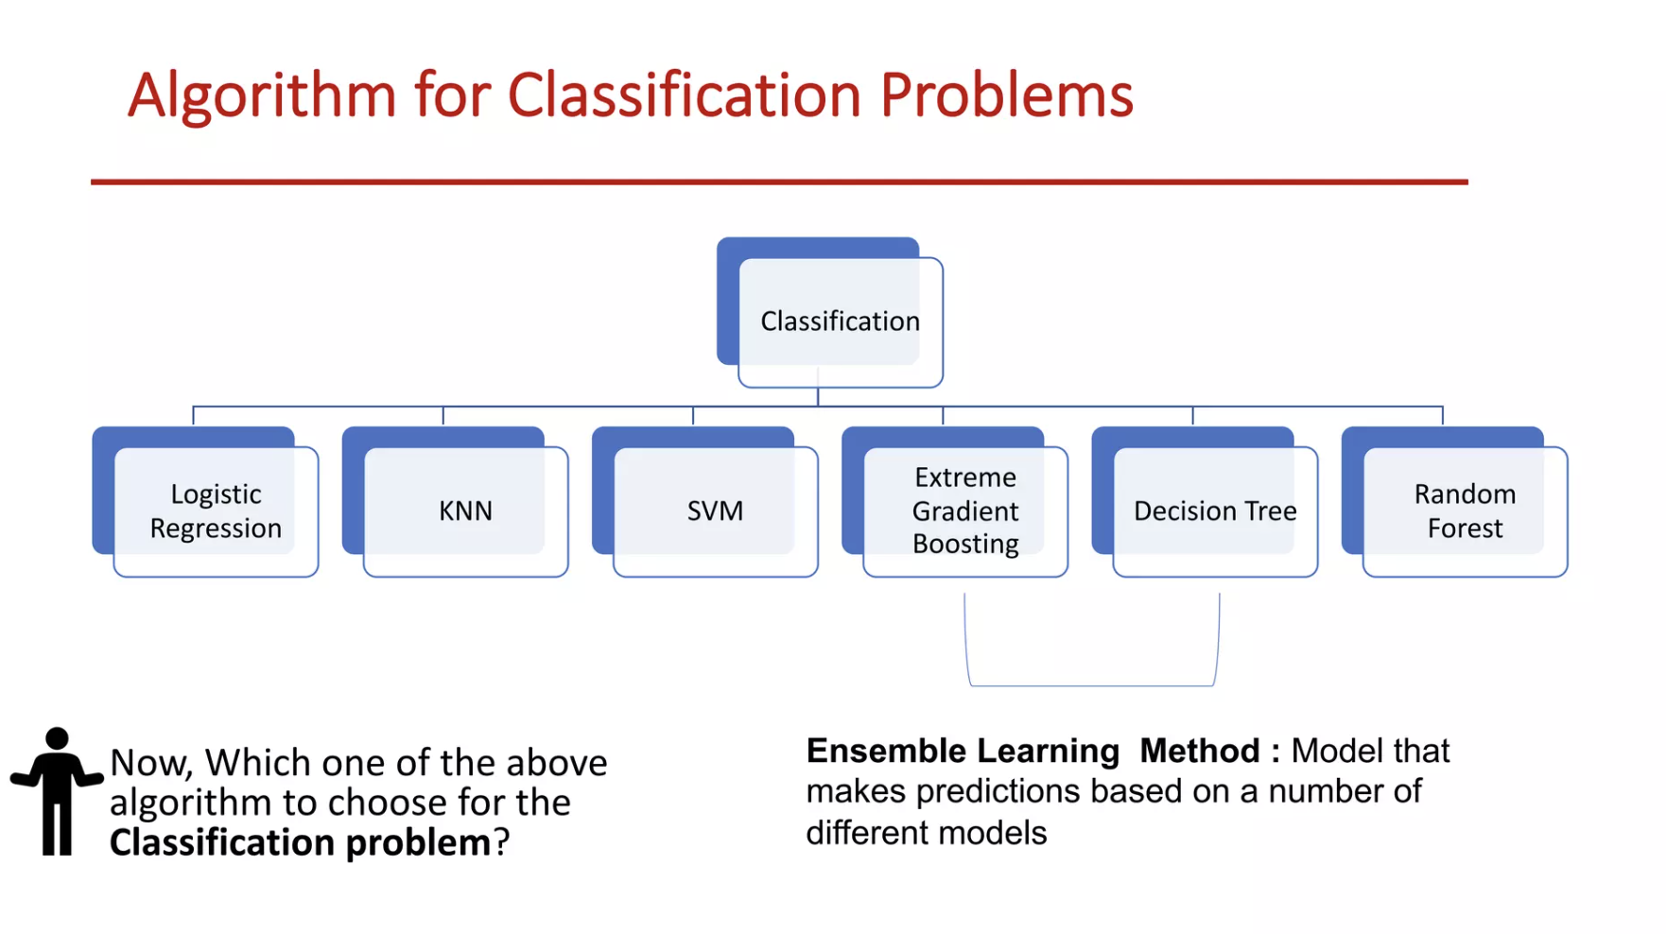

Slide 7
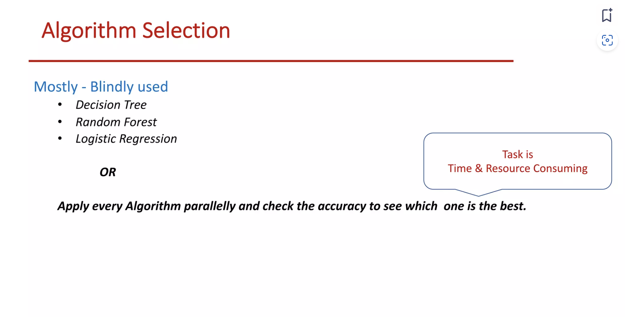

Slide 8
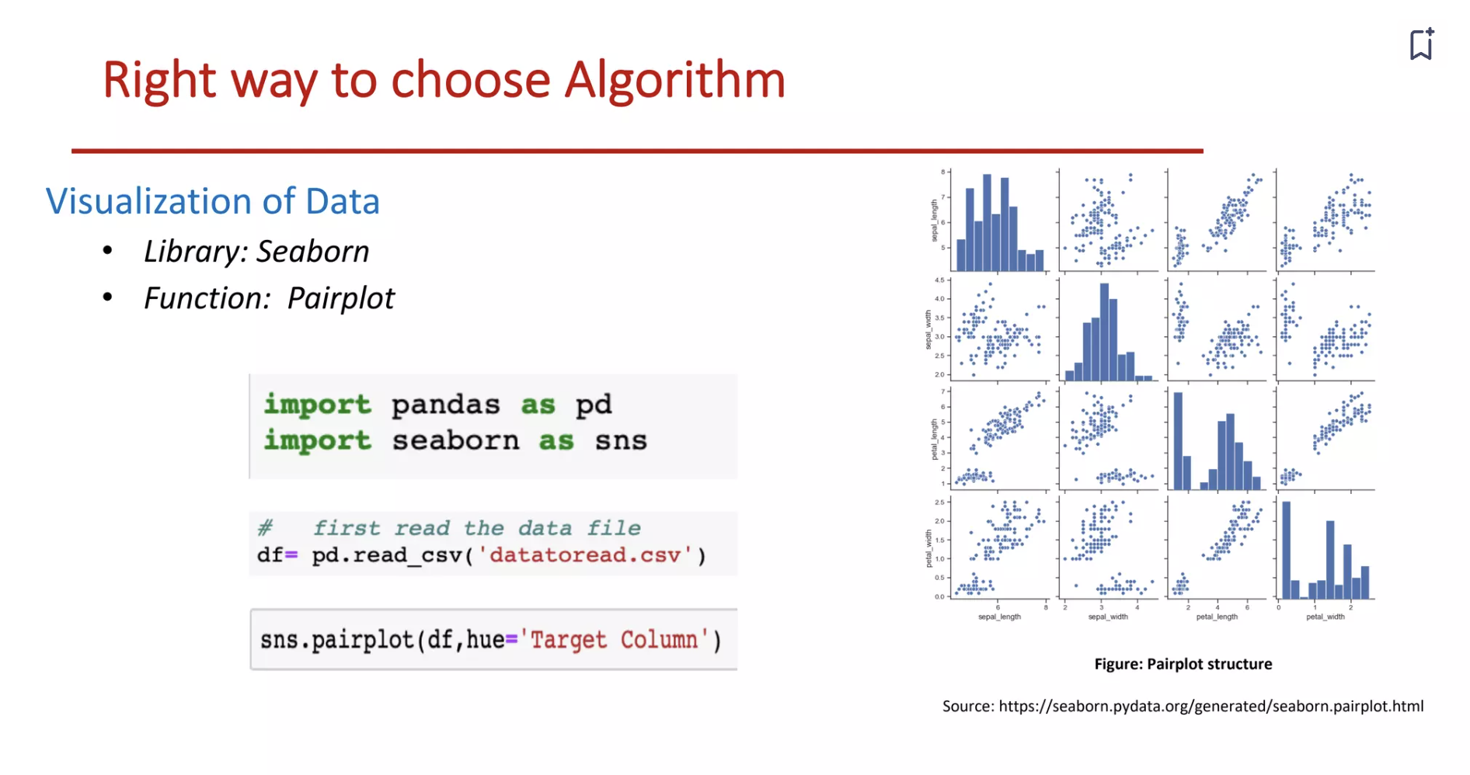

Slide 9
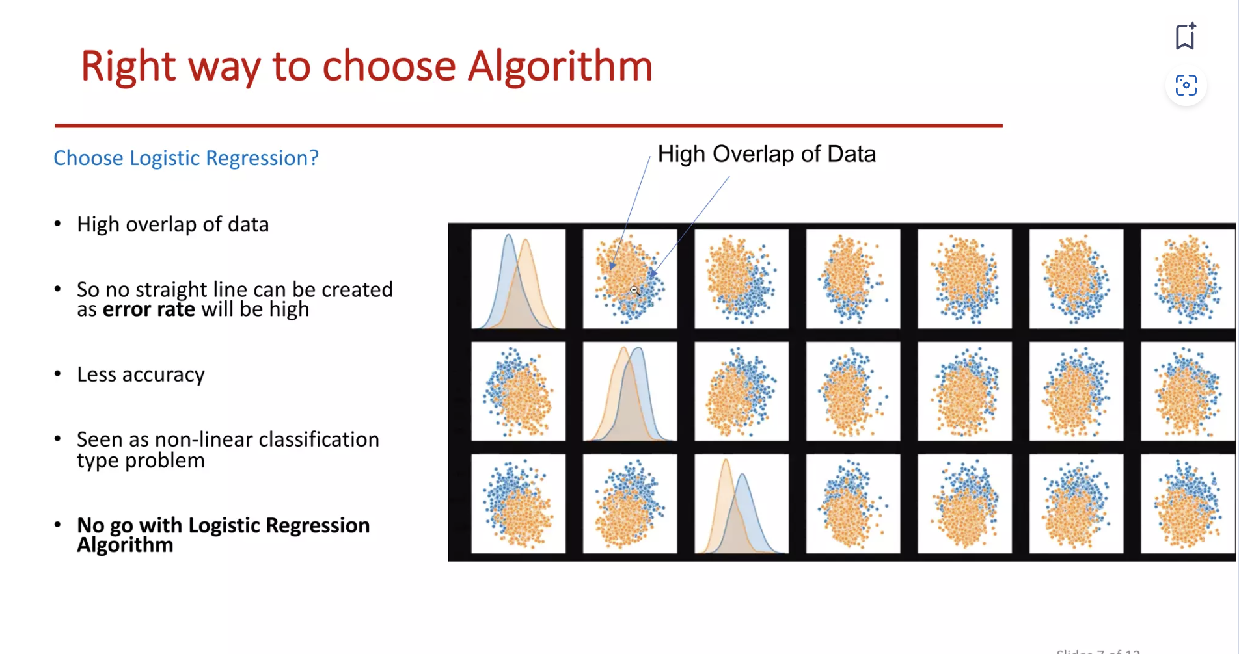

Slide 10
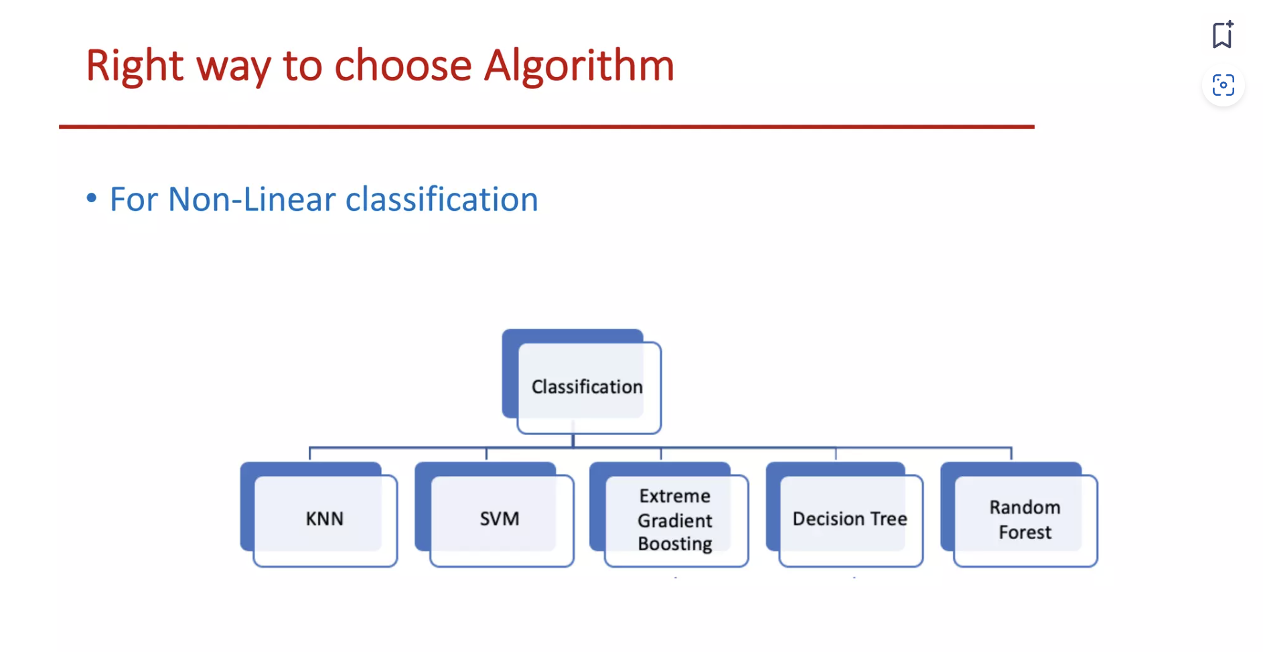

Slide 11
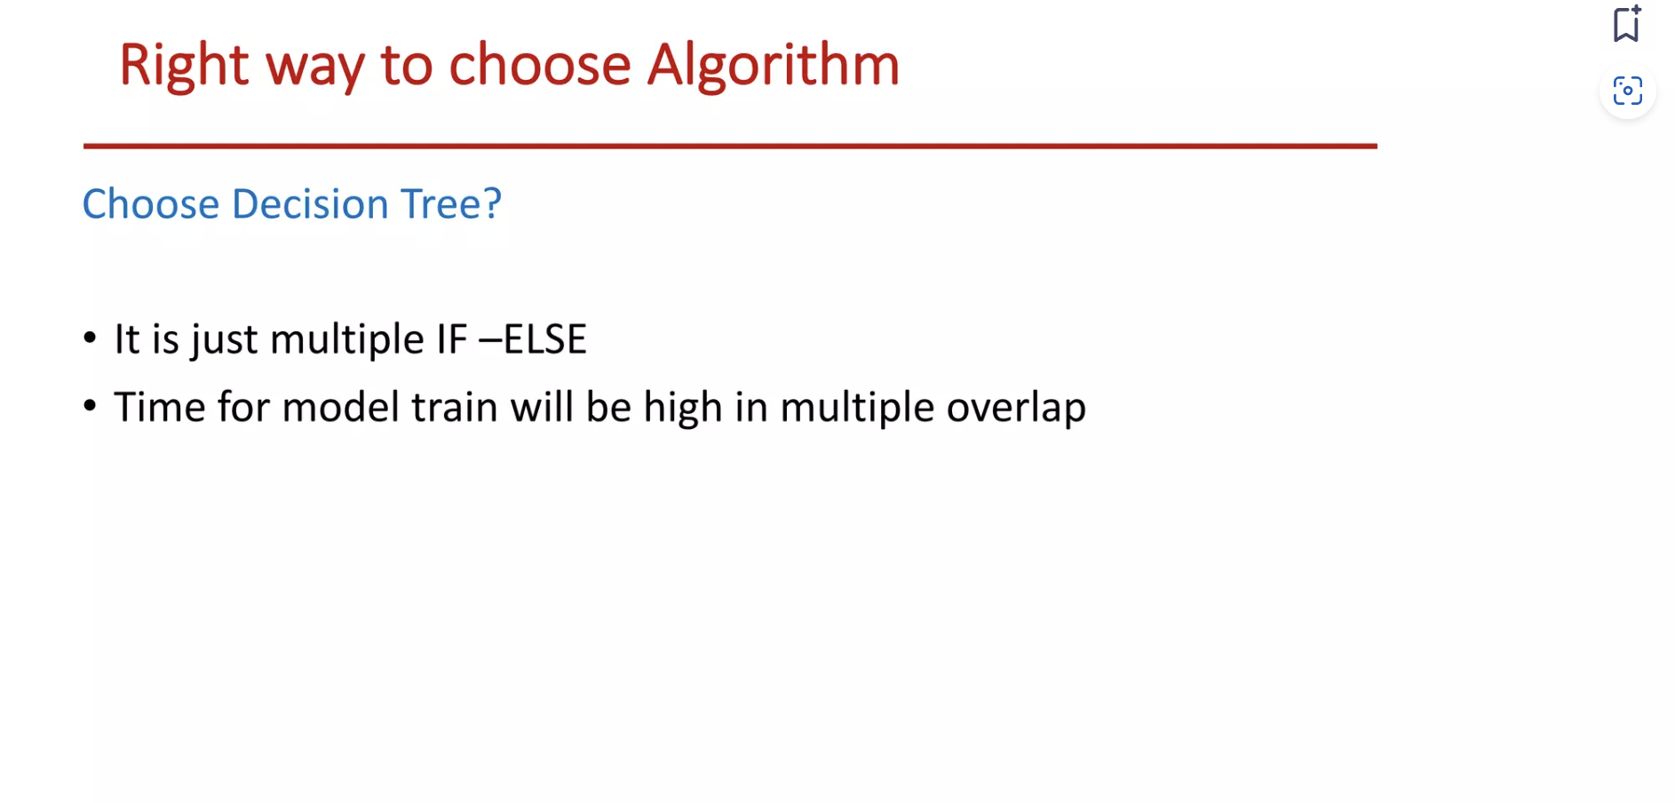

Slide 12
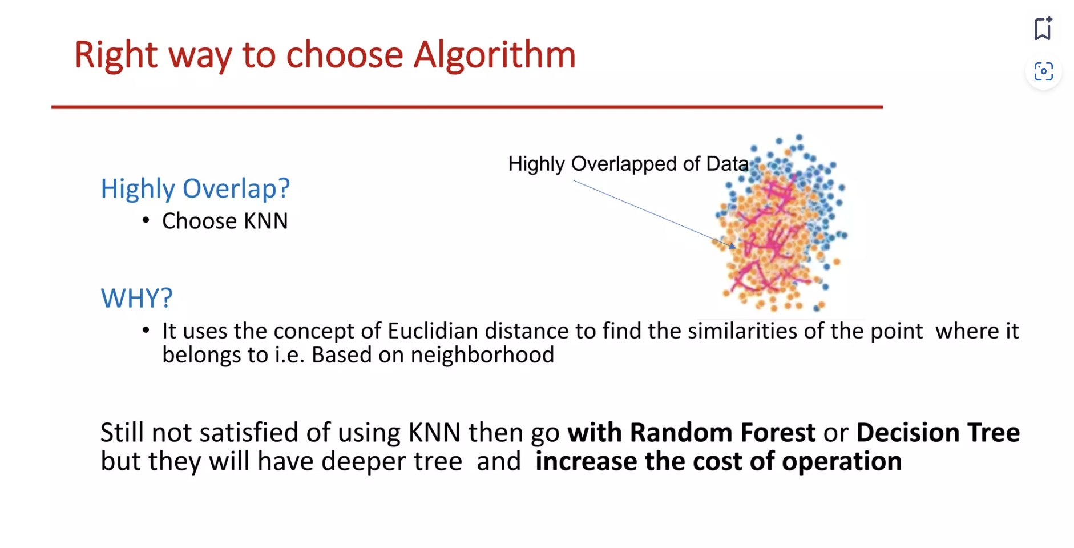

Slide 13
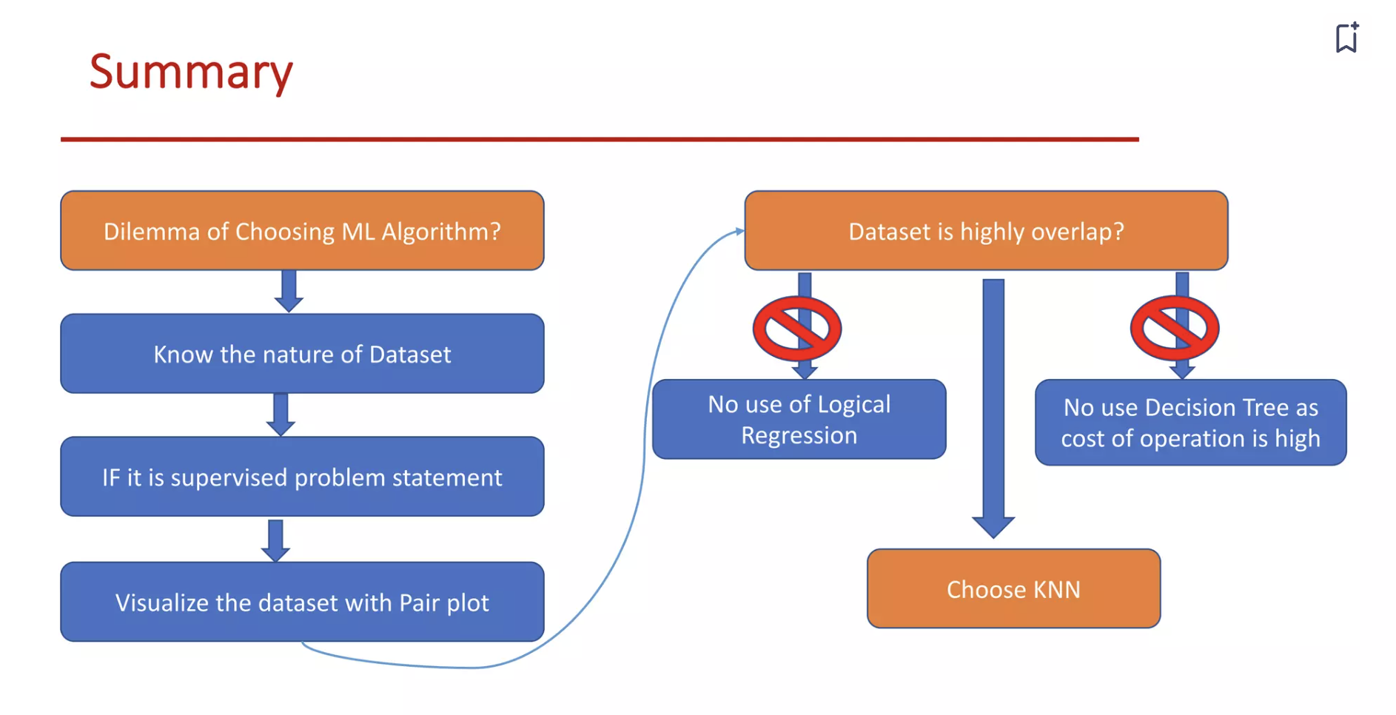

Slide 14
Introduction to Machine Learning with Scikit-Learn

Slide 15
"Feature engineering is the process of
transforming raw data into features that better
represent the underlying problem to the predictive models, resulting in improved model accuracy on unseen data."
– Jason Brownlee

Slide 16
“Coming up with features is difficult, time-consuming,
requires expert knowledge.
'Applied machine learning' isbasically
feature engineering.”
– Andrew Ng

Slide 17




The Dream...
Raw data
Dataset
Model
Task

Slide 18


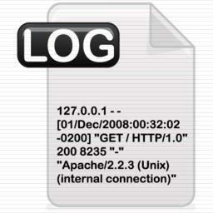





… The Reality
?
Features
?
Model
ML Ready dataset
Task
Raw data

Slide 19

More on scikit-learn
Data loading and pre-processing
Feature engineering
Hyperparameter tuning and Model evaluation

Slide 20
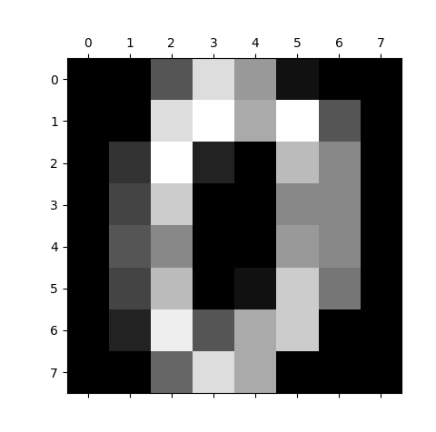
Load dataset
sklearn.datasets
Some „toy examples“ ready to use
datasets.load_iris()
datasets.load_wine()
Generate artificial data
>>> from sklearn.datasets import load_digits
>>> digits = load_digits()
>>> digits.data.shape
(1797, 64)
>>> digits.target_names
[0 1 2 3 4 5 6 7 8 9]
>>> import matplotlib.pyplot as plt
>>> plt.gray()
>>> plt.matshow(digits.images[0])
>>> plt.show()

Slide 21
Data pre-processing and transformation
Inputing for NaNs
Normalization / standardization
Transform nominals
Transform numeric
Data Aggregation
Feature extraction / combination
sklearn.preprocessing sklearn.feature_extraction sklearn.feature_selection

Slide 22
Exploratory Data Analysis (EDA)
Get the knowledge about your data
What does the data model look like?
What is the features distribution?
What are the features with missing or
inconsistent values?
What are the most predictive features?

Slide 23
Exploratory Data Analysis (EDA)
Get the knowledge about your data
get a basic description of the data
visualize it
identify patterns in it
identify challenges of using the data
form hypothesis about the data
- …

Slide 24
Exploratory Data Analysis (EDA)
Basic knowledge
Describe data (quantiles, med, mean, max, min…)
head(), tail()
Pd.Query(), sorting,
Challenges
NaNs, outliers, numeric -> nominal and vice versa Patterns
correlation, covariation, linear dependence, dimensionality reduction…
Visualization
boxpolots, histograms, cummulative distribution,
scatter plots, corr matrices, …

Slide 25
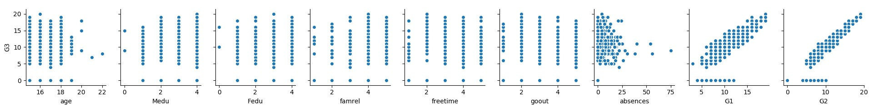
Exploratory Data Analysis (EDA) - pairplot
import pandas as pd
import seaborn as sns #statistical data visualization, based on matplotlib
import matplotlib.pyplot as plt
df = pd.read_csv("C:/Users/peska/Documents/uceni/2017_2018/NPRG065/cviceni/student-mat.csv", delimiter=";") sns.pairplot(data=df,
x_vars= ["age","Medu","Fedu","famrel","freetime","goout","absences","G1","G2"], y_vars= ['G3'])
plt.show()

Slide 26
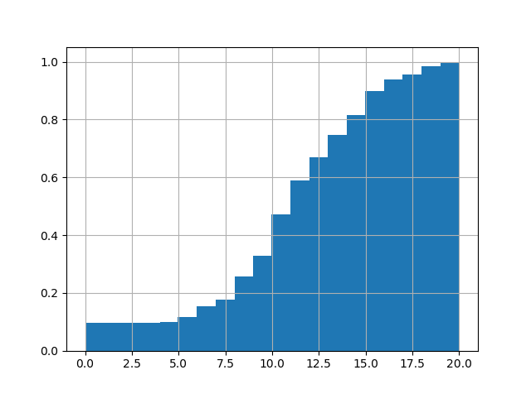
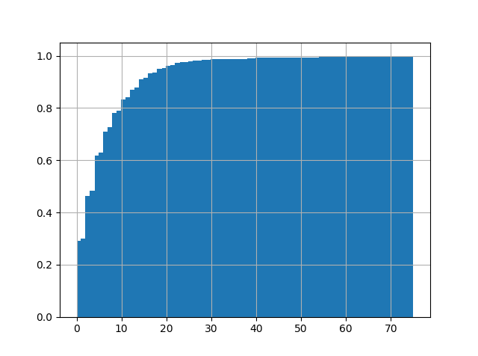
Exploratory Data Analysis (EDA) - CDF
import pandas as pd
import matplotlib.pyplot as plt
df = pd.read_csv("C:/Users/peska/Documents/uceni/2017_2018/NPRG065/cviceni/student-mat.csv", delimiter=";")
df.G3.hist(cumulative=True, normed=1, bins=len(df.G3))
#df.absences.hist(cumulative=True, normed=1, bins=len(df.absences)) plt.show()

Slide 27

Imputation for missing values
Datasets contain missing values, often encoded as blanks, NaNs or other placeholders
Ignoring rows and/or columns with missing values is possible, but at the price of
loosing data which might be valuable
Better strategy is to infer them from the known part of data
Strategies
Mean: Basic approach
Median: More robust to outliers
Mode: Most frequent value
Using a model: Can expose algorithmic bias

Slide 28
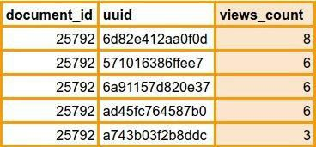
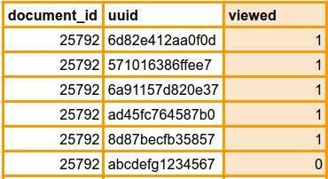
Binarization
Transform discrete or continuous numeric features in binary features
Example: Number of user views of the same document
>>> from sklearn import preprocessing
>>> X = [[ 1., -1., 2.],
... [ 2., 0., 0.],
... [ 0., 1., -1.]]
>>> binarizer = preprocessing.Binarizer(threshold=1.0)
>>> binarizer.transform(X)
array([[ 1., 0., 1.],
[ 1., 0., 0.],
[ 0., 1., 0.]])
Binarization with scikit-learn

Slide 29
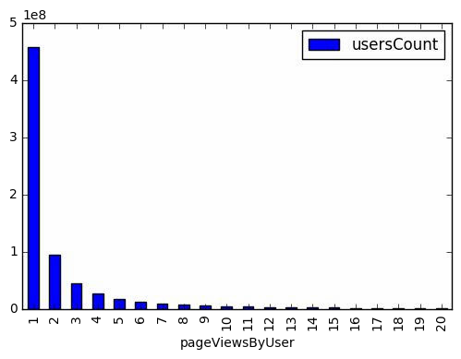
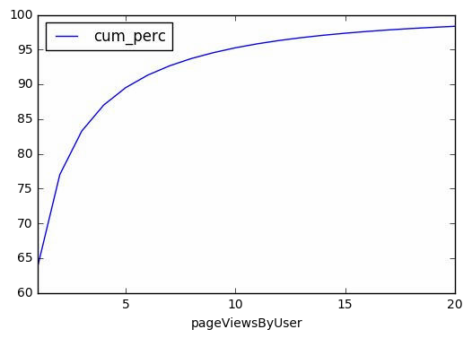
Binning
Split numerical values into bins and encode with a bin ID
Can be set arbitrarily or based on distribution
Fixed-width binning
Does fixed-width binning make sense for this long-tailed distribution?
Most users (458,234,809 ~ 5*10^8) had only 1 pageview during the period.
numpy.digitize

Slide 30
Scaling
Models that are smooth functions of input features are sensitive to the scale of the input (eg. Linear Regression)
Scale numerical variables into a certain range, dividing values by a normalization constant (no changes in single-feature distribution)
Popular techniques
MinMax Scaling
Standard (Z) Scaling

Slide 31
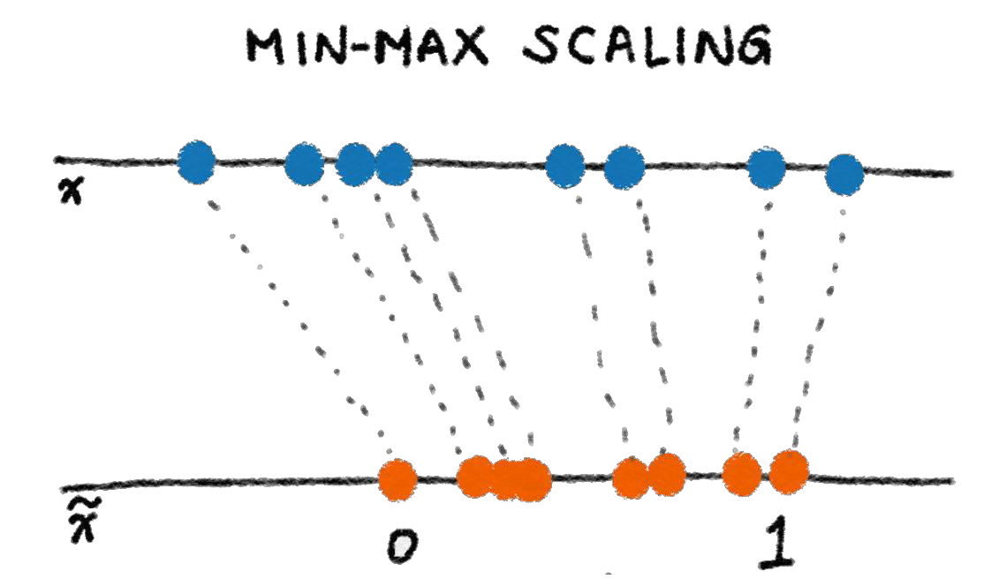
Min-max scaling
Squeezes (or stretches) all values within the range of [0, 1] to add robustness to very small standard deviations and preserving zeros for sparse data.
>>> from sklearn import preprocessing
>>> X_train = np.array([[ 1., -1., 2.],
... [ 2., 0., 0.],
... [ 0., 1., -1.]])
...
>>> min_max_scaler =
preprocessing.MinMaxScaler()
>>> X_train_minmax = min_max_scaler.fit_transform(X_train)
>>> X_train_minmax
array([[ 0.5 , 0. , 1. ],
[ 1.
, 0.5 , 0.33333333],
, 1. , 0. ]])
[ 0.
Min-max scaling with scikit-learn

Slide 32
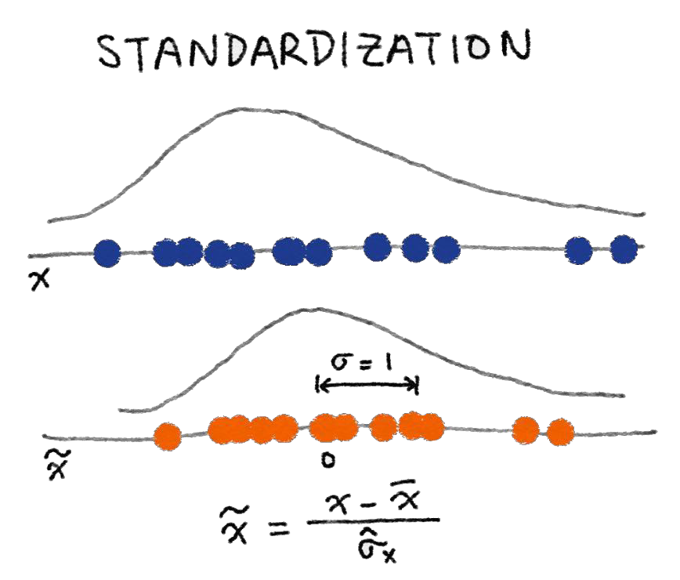
Standard (Z) Scaling
After Standardization, a feature has mean of 0 and variance of 1 (assumption of
many learning algorithms)
>>> from sklearn import preprocessing
>>> import numpy as np
>>> X = np.array([[ 1., -1., 2.],
... [ 2., 0., 0.],
... [ 0., 1., -1.]])
>>> X_scaled = preprocessing.scale(X)
>>> X_scaled
array([[ 0. ..., -1.22..., 1.33...],
[ 1.22..., 0. ..., -0.26...],
[-1.22..., 1.22..., -1.06...]])
>> X_scaled.mean(axis=0)
array([ 0., 0., 0.])
>>> X_scaled.std(axis=0) array([ 1., 1., 1.])
Standardization with scikit-learn

Slide 33
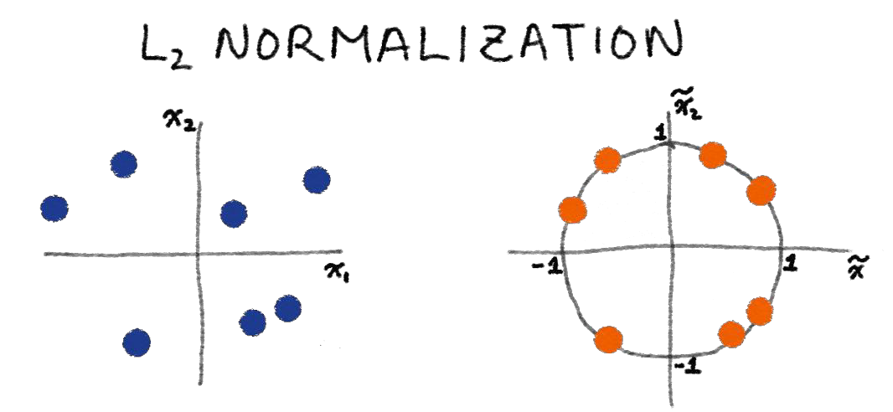

Normalization
Scales individual samples (rows) to have unit vector, dividing values by
vector’s L² norm, a.k.a. the Euclidean norm
Useful for quadratic form (like dot-product) or any other kernel to quantify similarity of pairs of samples. This assumption is the base of the Vector Space Model often used in text classification and clustering contexts
Normalized vector
Euclidean (L²) norm

Slide 34
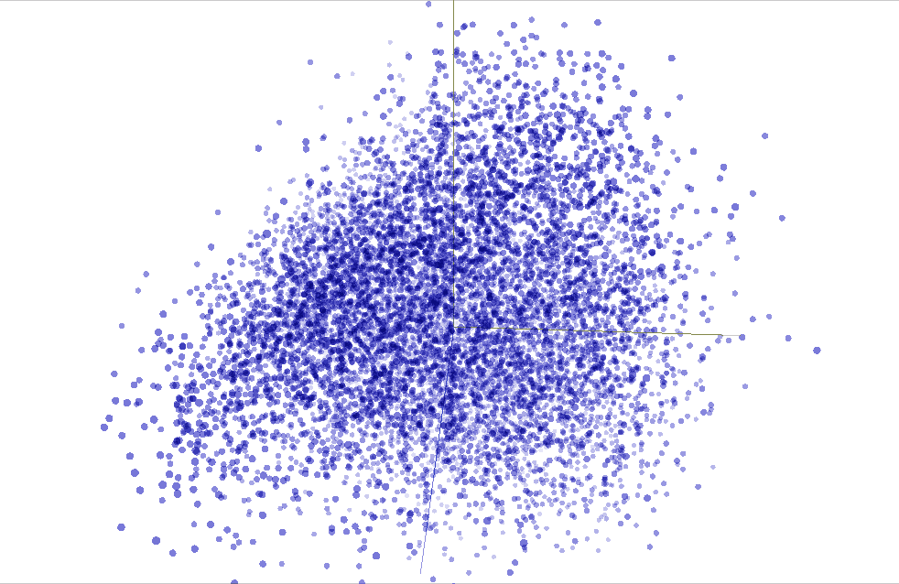

Slide 35
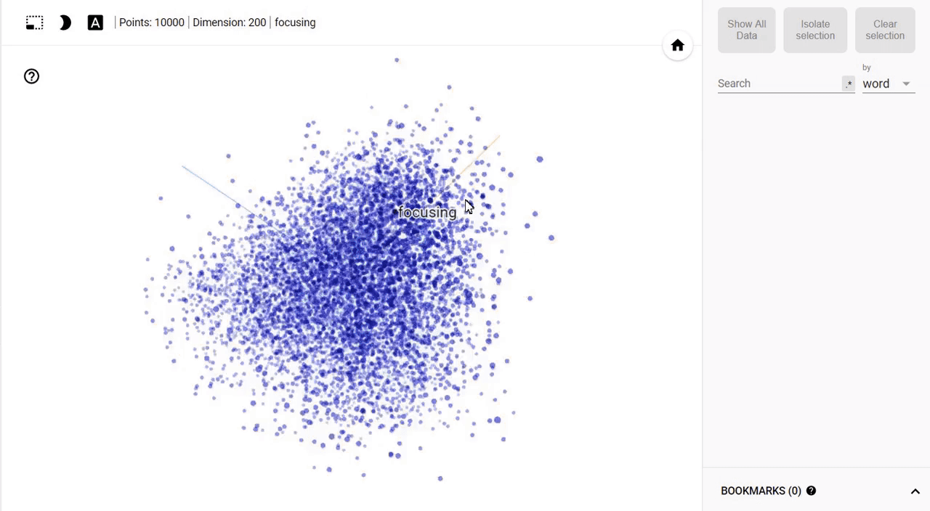

Slide 36
Normalization
>>> from sklearn import preprocessing
>>> X = [[ 1., -1., 2.],
... [ 2., 0., 0.],
... [ 0., 1., -1.]]
>>> X_normalized = preprocessing.normalize(X, norm='l2')
>>> X_normalized
array([[ 0.40..., -0.40..., 0.81...],
[ 1. ..., 0. ..., 0. ...],
[ 0. ..., 0.70..., -0.70...]])
Normalization with scikit-learn

Slide 37
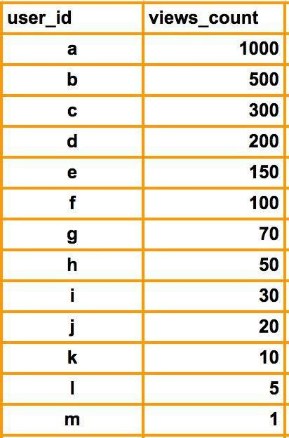
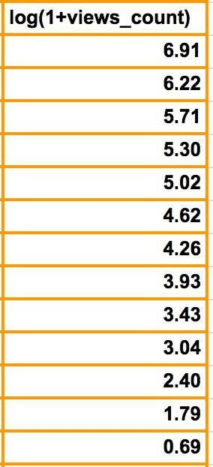
Log transformation
Compresses the range of large numbers and expand the range of small numbers. Eg. The larger x is, the slower log(x) increments.

Slide 38
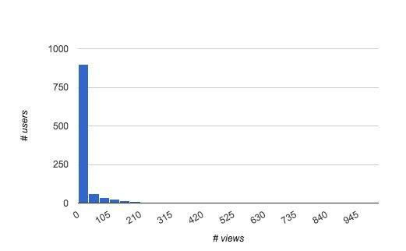
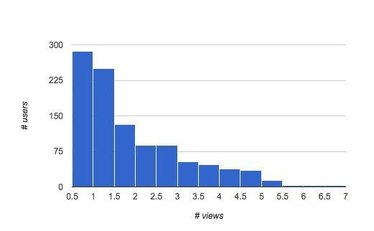
Log transformation
Smoothing long-tailed data with log
Histogram of # views by user
Histogram of # views by user smoothed by log(1+x)

Slide 39
Feature extraction

Slide 40
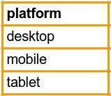
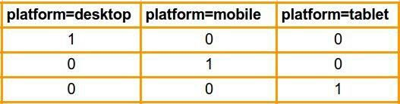
One-Hot Encoding (OHE)
Transform a categorical feature with m possible values into m binary features.
If the variable cannot be multiple categories at once, then only one bit in the
group can be on.
Sparse format is memory-friendly
sklearn.feature_extraction.DictVectorizer

Slide 41
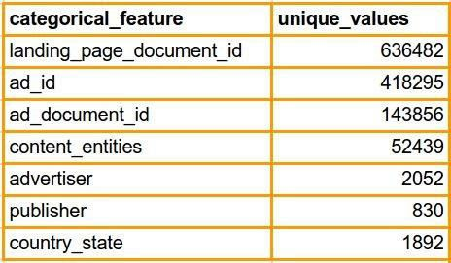
Large Categorical Variables
Common in applications like targeted advertising and fraud detection
Example:
Some large categorical features from Outbrain Click Prediction competition

Slide 42
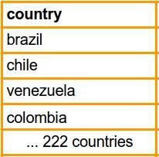
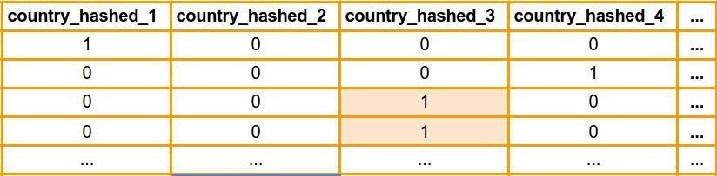
Feature hashing
Hashes categorical values into vectors with fixed-length.
Lower sparsity and higher compression compared to OHE
Deals with new and rare categorical values (eg: new user-agents)
May introduce collisions
100 hashed columns

Slide 43
Bin-counting
Instead of using the actual categorical value, use a global statistic of this category on historical data.
Useful for both linear and non-linear algorithms
May give collisions (same encoding for different categories)
Be careful about leakage
Strategies
Count
Average CTR

Slide 44
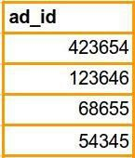
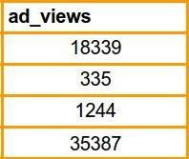
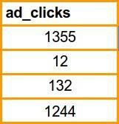
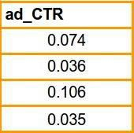
Bin-counting
or
or
Counts
Click-Through Rate
P(click | ad) = ad_clicks / ad_views

Slide 45
Textual features
sklearn.feature_extraction.text
Count, Tf-IDF,
Image features
sklearn.feature_extraction.image
Patches, img to graph,…

Slide 46
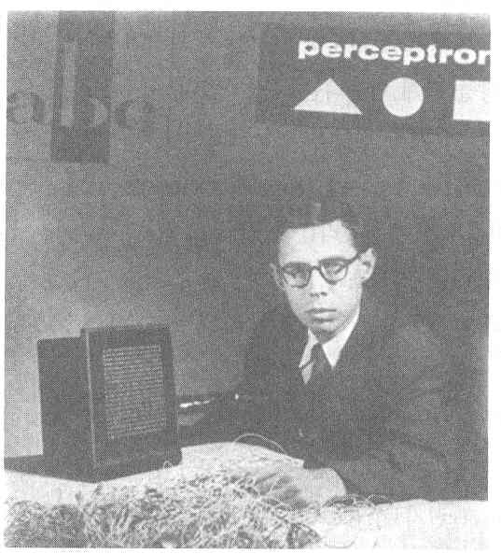
Perceptron
Cornell Aeronautical Laboratory
Perceptron
Invented by Frank Rosenblatt in 1957 in an attempt to understand human memory, learning, and cognitive processes.
The first neural network model by computation, with a remarkable learning algorithm:
If function can be represented by perceptron, the learning algorithm is guaranteed to quickly converge to the hidden function!
Became the foundation of pattern recognition research
Rosenblatt &
Mark I Perceptron:
the first machine that could "learn" to recognize and identify optical patterns.
One of the earliest and most influential neural networks:
An important milestone in AI.
Notes:
Perceptron invented by Frank Rosenblatt in 1957.
When perceptron was first introduced, this issue created considerable sensation.
Perceptron was the first neural network modeled by correct computation and affected many fields.
Perceptron also became the foundation of pattern recognition research.
<사진>
This guy is Frank Rosenblatt inventor of perceptron.
And this one is Mark ⅠPerceptron image sensor that is the first neural network equipment.

Slide 47
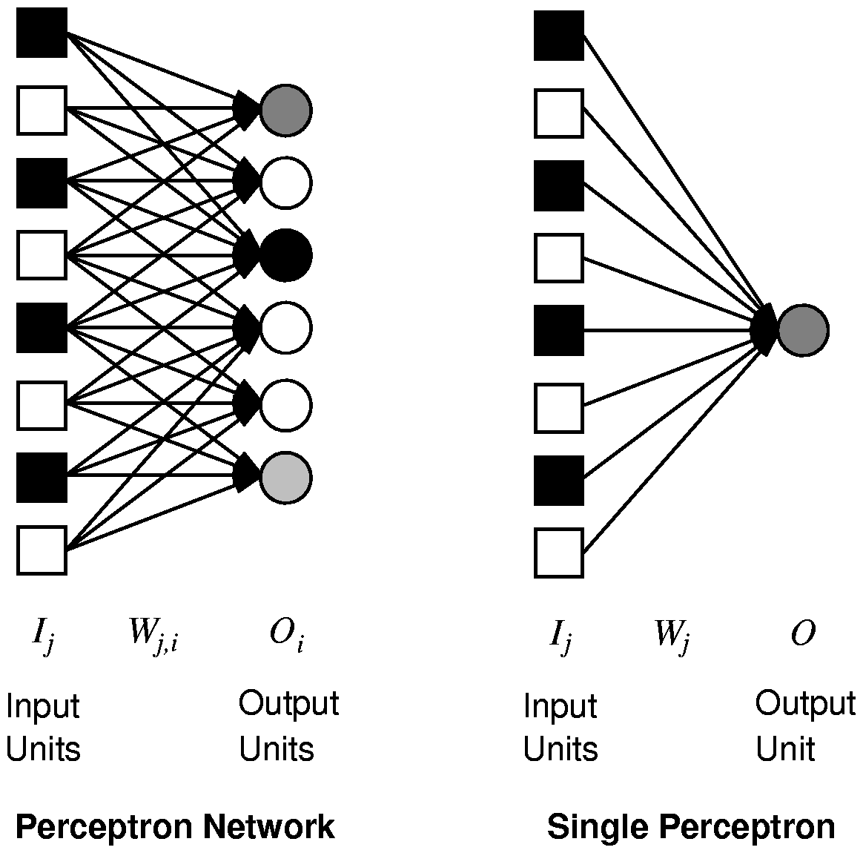
Single Layer Feed-forward Neural Networks Perceptrons
Single-layer neural network (perceptron network)
A network with all the inputs connected directly to the outputs
Output units all operate separately: no shared weights
Since each output unit is
independent of the others,
we can limit our study
to single output perceptrons.
Notes:
Single layer neural network also called perceptron network is a network with all the inputs connected directly to the outputs.
<그림 a>
This is a perceptron network consisting of three perceptron output units that share five inputs. Each output unit is independent of the others.
So we can limit our study to perceptrons with a single output unit.
<그림 b> --삭제해도 무관함
This is a graph of the output of a two-input perceptron unit using a sigmoid activation function.

Slide 48
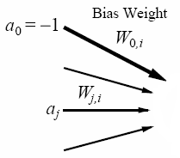



An Artificial Neuron Node or Unit: A Mathematical Abstraction
Artificial Neuron,
Node or unit ,
Processing Unit i
Input
function(in_{i}):
weighted sum
of its inputs,
including
fixed input a₀.
Output
Input edges,
each with weights
(positive, negative, and
change over time,
learning)
Activation
function (g)
applied to
input function
(typically
non-linear).
Output edges,
each with weights
(positive, negative, and
change over time,
learning)
→ a processing element producing an output based on a function of its inputs
Note: the fixed input and bias weight are conventional; some authors instead, e.g., or a₀=1 and -W_{0i}
Notes:
A Node is a processing element which produces an output based on a function of it’s inputs:
Winston, p. 445
Simulated neuron is viewed as a…Node connected to other nodes.
Links are the axons and dendrites.
Link associated with a weight. Like a synapse, that weight determines the nature and strength of one node’s influence on another.
Weights are the primary means for long-term storage (plasticity).
One node’s influence on another is the output value of the first times the weight on the connecting link. Large/small, +/- weight corresponds to strong/weak excitation/inhibition. (Models combining influences of set of dendrites).
Output of each node is determined by an activation function. Usually a threshold function. Combines the influences from input links. Sum of weighted inputs. Output is either 0 or 1. (Models the cell body.)
Note: Many facets of real neurons are NOT modeled.

Slide 49




Activation Functions
Threshold activation function → a step function or threshold function
(outputs 1 when the input is positive; 0 otherwise).
(b) Sigmoid (or logistics function) activation function (key advantage: differentiable)
(c) Sign function, +1 if input is positive, otherwise -1.
These functions have a threshold (either hard or soft) at zero.
→ Changing the bias weight W_{0,i} moves the threshold location.

Slide 50






Training NNs
Optimizing the loss function $ℒ\left(θ\right)$
Almost all DL models these days are trained with a variant of the gradient descent (GD) algorithm
GD applies iterative refinement of the network parameters$θ$
GD uses the opposite direction of the gradient of the loss with respect to the NN parameters (i.e.,$∇ℒ\left(θ\right)=\left[{∂ℒ}/{∂θ_{i}}\right]$ ) for updating $θ$
The gradient of the loss function $∇ℒ\left(θ\right)$ gives the direction of fastest increase of the loss function $ℒ\left(θ\right)$ when the parameters$θ$ are changed
$$ℒ\left(θ\right)$$
$$\frac{∂ℒ}{∂θ_{i}}$$
$$θ_{i}$$

Slide 51

Training NNs
The loss functions for most DL tasks are defined over very high-dimensional spaces
E.g., ResNet50 NN has about 23 million parameters
This makes the loss function impossible to visualize
We can still gain intuitions by studying 1-dimensional and 2-dimensional examples of loss functions
1D loss (the minimum point is obvious)
2D loss (blue = low loss, red = high loss)
Picture from: https://cs231n.github.io/optimization-1/

Slide 52


Gradient Descent Algorithm
Steps in the gradient descent algorithm:
Randomly initialize the model parameters$,θ^{0}$
In the figure, the parameters are denoted $w$
Compute the gradient of the loss function at $θ^{0}$: $∇ℒ\left(θ^{0}\right)$
Update the parameters as: $θ^{new}=θ^{0}−α∇ℒ\left(θ^{0}\right)$
Where α is the learning rate
Go to step 2 and repeat (until a terminating criterion is reached)

Slide 53













Gradient Descent Algorithm
Example: a NN with only 2 parameters $w_{1}$ and $w_{2}$, i.e., $θ=\left\{w_{1},w_{2}\right\}$
Different colors are the values of the loss (minimum loss$θ^{∗}$ is ≈ 1.3)
1. Randomly pick a starting point $θ^{0}$
2. Compute the gradient at $θ^{0}$, $∇ℒ\left(θ^{0}\right)$
$$θ^{∗}$$
$$w_{2}$$
3. Times the learning rate $η$, and update $θ,$
$$θ^{new}=θ^{0}−α∇ℒ\left(θ^{0}\right)$$
$$θ^{1}$$
$$θ^{1}=$$
$$θ^{0}−α∇ℒ\left(θ^{0}\right)$$
$$−∇ℒ\left(θ^{0}\right)$$
4. Go to step 2, repeat
$$θ^{0}$$
$$∇ℒ\left(θ^{0}\right)=\left[\begin{matrix}∂ℒ\left(θ^{0}\right)/∂w_{1} \\ ∂ℒ\left(θ^{0}\right)/∂w_{2}\end{matrix}\right]$$
$$w_{1}$$
Slide credit: Hung-yi Lee – Deep Learning Tutorial

Slide 54






Gradient Descent Algorithm
Example (contd.)
Eventually, we would reach a minimum …..
1. Randomly pick a starting point $θ^{0}$
2. Compute the gradient at $θ^{0}$,$∇ℒ\left(θ^{0}\right)$
$$θ^{2}$$
$$θ^{1}−α∇ℒ\left(θ^{1}\right)$$
3. Times the learning rate $η$, and update $θ,$
$$θ^{new}=θ^{0}−α∇ℒ\left(θ^{0}\right)$$
$$w_{2}$$
$$θ^{2}−α∇ℒ\left(θ^{2}\right)$$
$$θ^{1}$$
4. Go to step 2, repeat
$$θ^{0}$$
$$w_{1}$$
Slide credit: Hung-yi Lee – Deep Learning Tutorial

Slide 55




Gradient Descent Algorithm
Gradient descent algorithm stops when a local minimum of the loss surface is reached
GD does not guarantee reaching a global minimum
However, empirical evidence suggests that GD works well for NNs
$ℒ\left(θ\right)$
$$θ$$
Picture from: https://blog.paperspace.com/intro-to-optimization-in-deep-learning-gradient-descent/

Slide 56






Gradient Descent Algorithm
For most tasks, the loss surface $ℒ\left(θ\right)$ is highly complex (and non-convex)
Random initialization in NNs results in different initial parameters $θ^{0}$
Gradient descent may reach different minima at every run
Therefore, NN will produce different predicted outputs
Currently, we don’t have an algorithm that guarantees reaching a global minimum for an arbitrary loss function
$$ℒ$$
$$w_{1}$$
$$w_{2}$$
Slide credit: Hung-yi Lee – Deep Learning Tutorial

Slide 57
Backpropagation
How to calculate the gradients of the loss function in NNs?
There are two ways:
Numerical gradient: slow, approximate, but easy way
Analytic gradient: requires calculus, fast, but more error-prone way
In practice the analytic gradient is used
Analytical differentiation for gradient computation is available in almost all deep learning libraries

Slide 58

Mini-batch Gradient Descent
It is wasteful to compute the loss over the entire set to perform a single parameter update for large datasets
E.g., ImageNet has 14M images
GD (a.k.a. vanilla GD) is replaced with mini-batch GD
Mini-batch gradient descent
Approach:
Compute the loss $ℒ\left(θ\right)$ on a batch of images, update the parameters $θ$, and repeat until all images are used
At the next epoch, shuffle the training data, and repeat above process
Mini-batch GD results in much faster training
Typical batch size: 32 to 256 images
It works because the examples in the training data are correlated
I.e., the gradient from a mini-batch is a good approximation of the gradient of the entire training set

Slide 59

Stochastic Gradient Descent
Stochastic gradient descent
SGD uses mini-batches that consist of a single input example
E.g., one image mini-batch
Although this method is very fast, it may cause significant fluctuations in the loss function
Therefore, it is less commonly used, and mini-batch GD is preferred
In most DL libraries, SGD is typically a mini-batch SGD (with an option to add momentum)

Slide 60





Problems with Gradient Descent
Besides the local minima problem, the GD algorithm can be very slow at plateaus, and it can get stuck at saddle points
cost $ℒ\left(θ\right)$
Very slow at the plateau
Stuck at a saddle point
Stuck at a local minimum
$$∇ℒ\left(θ\right)≈0$$
$$∇ℒ\left(θ\right)=0$$
$$∇ℒ\left(θ\right)=0$$
$$θ$$
Slide credit: Hung-yi Lee – Deep Learning Tutorial

Slide 61


Gradient Descent with Momentum
Gradient descent with momentum uses the momentum of the gradient for parameter optimization
cost $ℒ\left(θ\right)$
Movement = Negative of Gradient + Momentum
Negative of Gradient
Momentum
Real Movement
$$θ$$
Gradient = 0
Slide credit: Hung-yi Lee – Deep Learning Tutorial

Slide 62

Gradient Descent with Momentum
Parameters update in GD with momentum : $θ^{new}=θ^{old}−V^{new}$
Where: $V^{new}$= $βV^{old}+α∇ℒ\left(θ^{old}\right)$
Compare to vanilla GD: $θ^{new}=θ^{old}−α∇ℒ\left(θ^{old}\right)$
The term $V^{new}$ is called momentum
This term accumulates the gradients from the past several steps
It is similar to a momentum of a heavy ball rolling down the hill
The parameter$β$ referred to as a coefficient of momentum
A typical value of the parameter $β$ is 0.9
This method updates the parameters $θ$ in the direction of the weighted average of the past gradients

Slide 63


Nesterov Accelerated Momentum
Gradient descent with Nesterov accelerated momentum
Parameters update: $θ^{new}=θ^{old}−V^{new}$
Where: $V^{new}$= $βV^{old}+α∇ℒ\left(θ^{old}−βV^{old}\right)$
The term $θ^{old}−βV^{old}$ allows us to predict the position of the parameters in the next step (i.e., $θ^{next} ≈θ^{old}−βV^{old}$)
The gradient is calculated with respect to the approximate future position of the parameters in the next step, $θ^{next}$
GD with momentum
GD with Nesterov momentum
Picture from: https://towardsdatascience.com/learning-parameters-part-2-a190bef2d12

Slide 64


Learning Rate
Learning rate
The gradient tells us the direction in which the loss has the steepest rate of increase, but it does not tell us how far along the opposite direction we should step
Choosing the learning rate (also called the step size) is one of the most important hyper-parameter settings for NN training
LR too small
LR too large

Slide 65

Learning Rate
Training loss for different learning rates
High learning rate: the loss increases or plateaus too quickly
Low learning rate: the loss decreases too slowly (takes many epochs to reach a solution)
Picture from: https://cs231n.github.io/neural-networks-3/

Slide 66
Logistic Regression
Background: Generative and Discriminative Classifiers
Notes:
In this lecture we talk about the difference between generative and discriminative classifiers, and the relationship between Naïve Bayes and Logistic Regression.

Slide 67
Logistic Regression
Important analytic tool in natural and social sciences
Baseline supervised machine learning tool for classification
Is also the foundation of neural networks

Slide 68
Generative and Discriminative Classifiers
Naive Bayes is a generative classifier: Generative models aim to model the joint probability distribution of the input features and the class labels, i.e., they learn how the data is generated.
by contrast:
Logistic regression is a discriminative classifier: Discriminative models focus on modeling the conditional probability of the class labels given the input features. Instead of modeling how the data is generated, they directly learn the decision boundary between different classes.

Slide 69


Generative and Discriminative Classifiers
Suppose we're distinguishing cat from dog images
imagenet
imagenet

Slide 70
Generative Classifier:
Build a model of what's in a cat image
Knows about whiskers, ears, eyes
Assigns a probability to any image:
how cat-y is this image?
Also build a model for dog images
Now given a new image:
Run both models and see which one fits better

Slide 71
Discriminative Classifier
Just try to distinguish dogs from cats
Oh look, dogs have collars!
Let's ignore everything else

Slide 72
Finding the correct class c from a document d in Generative vs Discriminative Classifiers
Naive Bayes
Logistic Regression
posterior
P(c|d)

Slide 73

Components of a probabilistic machine learning classifier
Given m input/output pairs (x^{(i),}y^{(i)}):
A feature representation of the input. For each input observation x^{(i)}, a vector of features [x₁, x₂, ... , x_{n}]. Feature j for input x^{(i)} is x_{j}, more completely x_{j}^{(i)}, or sometimes f_{j}(x).
A classification function that computes $\hat{y}$, the estimated class, via p(y|x), like the sigmoid or softmax functions.
An objective function for learning, like cross-entropy loss.
An algorithm for optimizing the objective function: stochastic gradient descent.

Slide 74
The two phases of logistic regression
Training: we learn weights w and b using stochastic gradient descent and cross-entropy loss.
Test: Given a test example x we compute p(y|x) using learned weights w and b, and return whichever label (y = 1 or y = 0) is higher probability

Slide 75
Logistic Regression
Background: Generative and Discriminative Classifiers
Notes:
We've now seen the high-level intuition of the components of logistic regression and its relationship to the other classifier we've learned about, Naïve Bayes

Slide 76
Logistic Regression
Classification in Logistic Regression
Notes:
In this lecture we'll see how to do classification with logistic regression and introduce the important sigmoid function

Slide 77

Classification Reminder
Positive/negative sentiment
Spam/not spam
Authorship attribution (Hamilton or Madison?)
Alexander Hamilton

Slide 78

Text Classification: definition
Input:
a document x
a fixed set of classes C = {c₁, c₂,…, c_{J}}
Output: a predicted class $\hat{y}$ ∈ C

Slide 79

Binary Classification in Logistic Regression
Given a series of input/output pairs:
(x^{(i)}, y^{(i)})
For each observation x^{(i)}
We represent x^{(i)} by a feature vector [x₁, x₂,…, x_{n}]
We compute an output: a predicted class $\hat{y}$^{(i)} ∈ {0,1}

Slide 80
Features in logistic regression
For feature x_{i}, weight w_{i} tells is how important is x_{i}
x_{i} ="review contains ‘awesome’": w_{i} = +10
x_{j} ="review contains ‘abysmal’": w_{j} = -10
x_{k} =“review contains ‘mediocre’": w_{k} = -2
Notes:
The weight wi represents how important that input feature is to the classification decision, and can be positive (providing evidence that the in- stance being classified belongs in the positive class) or negative (providing evidence that the instance being classified belongs in the negative class). Thus we might expect in a sentiment task the word awesome to have a high positive weight, and abysmal to have a very negative weight.

Slide 81


Logistic Regression for one observation x
Input observation: vector x = [x₁, x₂,…, x_{n}]
Weights: one per feature: W = [w₁, w₂,…, w_{n}]
Sometimes we call the weights θ = [θ₁, θ₂,…, θ_{n}]
Output: a predicted class $\hat{y}$ ∈ {0,1}
(multinomial logistic regression: $\hat{y}$ ∈ {0, 1, 2, 3, 4})

Slide 82
How to do classification
For each feature x_{i}, weight w_{i} tells us importance of x_{i}
(Plus we'll have a bias b)
We'll sum up all the weighted features and the bias
If this sum is high, we say y=1; if low, then y=0
Notes:
The bias term, also called the intercept, is another real number that’s added to the weighted inputs. In the rest of the book we’ll represent such sums using the dot product notation from linear algebra. The dot product of two vectors a and b, written as a · b is the sum of the products of the corresponding elements of each vector.

Slide 83
But we want a probabilistic classifier
We need to formalize “sum is high”.
We’d like a principled classifier that gives us a probability, just like Naive Bayes did
We want a model that can tell us:
p(y=1|x; θ)
p(y=0|x; θ)

Slide 84
The problem: z isn't a probability, it's just a number!
Solution: use a function of z that goes from 0 to 1
Notes:
nothing in Eq. 5.3 forces z to be a legal probability, that is, to lie between 0 and 1. In fact, since weights are real-valued, the output might even be negative; z ranges from −∞ to ∞.

Slide 85
The very useful sigmoid or logistic function
Notes:
The sigmoid function The 1/1+e^-z (so-named because it looks like an s) is also called the logistic function. It takes a real value and maps it to the range [0, 1
It is nearly linear around 0 but outlier values get squashed toward 0 or 1.

Slide 86
Idea of logistic regression
We’ll compute w∙x+b
And then we’ll pass it through the sigmoid function:
σ(w∙x+b)
And we'll just treat it as a probability

Slide 87
Making probabilities with sigmoids
Notes:
We’re almost there. If we apply the sigmoid to the sum of the weighted features, we get a number between 0 and 1. To make it a probability, we just need to make sure that the two cases, p(y = 1) and p(y = 0), sum to 1. We can do this as follows:

Slide 88
Turning a probability into a classifier
0.5 here is called the decision boundary

Slide 89
If you increase the decision boundary (e.g., 0.7), you become more conservative in predicting the positive class, potentially reducing false positives at the cost of potentially missing some true positives.
If you decrease the decision boundary (e.g., 0.3), you become more liberal in predicting the positive class, potentially increasing false positives but catching more true positives.

Slide 90
The probabilistic classifier
P(y=1)
wx + b

Slide 91
Turning a probability into a classifier
if w∙x+b > 0
if w∙x+b ≤ 0

Slide 92
Logistic Regression
Classification in Logistic Regression
Notes:
We've seen how logistic regression uses the sigmoid function to take weighted features for an input example x and assign it to the class 1 or 0.

Slide 93
Logistic Regression
Logistic Regression: a text example on sentiment classification
Notes:
Let's walk through an example using logistic regression to do sentiment classification

Slide 94
Sentiment example: does y=1 or y=0?
It's hokey . There are virtually no surprises , and the writing is second-rate . So why was it so enjoyable ? For one thing , the cast is
great . Another nice touch is the music . I was overcome with the urge to get off the couch and start dancing . It sucked me in , and it'll do the same to you .
Notes:
Suppose we are doing binary sentiment classification on movie review text, and we would like to know whether to assign the sentiment class 1=positive or 0=negative to the following review

Slide 95
Notes:
We’ll represent each input observation by the 6 features x1...x6 of the input

Slide 96
Classifying sentiment for input x
Suppose w =
b = 0.1
Notes:
Let’s assume for the moment that we’ve already learned a real-valued weight for each of these features, and that the 6 weights corresponding to the 6 features are as follows. The weight w1, for example indicates how important a feature the number of positive lexicon words (great, nice, enjoyable, etc.) is to a positive sentiment decision, while w2 tells us the importance of negative lexicon words. Note that w1 = 2.5 is positive, while w2 = −5.0, meaning that negative words are negatively associated with a positive sentiment decision, and are about twice as important as positive words.

Slide 97
Classifying sentiment for input x
Notes:
Given these 6 features and the input review x, we can compute P(+|x) and P(−|x)

Slide 98
History of SVM
SVM is related to statistical learning theory [3]
SVM was first introduced in 1992 [1]
SVM becomes popular because of its success in handwritten digit recognition
1.1% test error rate for SVM. This is the same as the error rates of a carefully constructed neural network, LeNet 4.
See Section 5.11 in [2] or the discussion in [3] for details
SVM is now regarded as an important example of “kernel methods”, one of the key area in machine learning
Note: the meaning of “kernel” is different from the “kernel” function for Parzen windows
[1] B.E. Boser et al. A Training Algorithm for Optimal Margin Classifiers. Proceedings of the Fifth Annual Workshop on Computational Learning Theory 5 144-152, Pittsburgh, 1992.
[2] L. Bottou et al. Comparison of classifier methods: a case study in handwritten digit recognition. Proceedings of the 12th IAPR International Conference on Pattern Recognition, vol. 2, pp. 77-82.
[3] V. Vapnik. The Nature of Statistical Learning Theory. 2nd edition, Springer, 1999.
Notes:
First introduced in COLT-92 by Boser, Guyon and Vapnik
COLT = computational learning theory
B. Scholkopf et al. ICANN 96. 47-52.

Slide 99
Linear Classifiers
Estimation:
x
f
y^{est}
f(x,w,b) = sign(w. x - b)
denotes +1
denotes -1
w: weight vector
x: data vector
How would you classify this data?

Slide 100
Linear Classifiers
α
x
f
y^{est}
f(x,w,b) = sign(w. x - b)
denotes +1
denotes -1
How would you classify this data?

Slide 101
Linear Classifiers
α
x
f
y^{est}
f(x,w,b) = sign(w. x - b)
denotes +1
denotes -1
How would you classify this data?

Slide 102
Linear Classifiers
α
x
f
y^{est}
f(x,w,b) = sign(w. x - b)
denotes +1
denotes -1
How would you classify this data?

Slide 103
Linear Classifiers
α
x
f
y^{est}
f(x,w,b) = sign(w. x - b)
denotes +1
denotes -1
Any of these would be fine..
..but which is best?

Slide 104
Classifier Margin
α
x
f
y^{est}
f(x,w,b) = sign(w. x - b)
denotes +1
denotes -1
Define the margin of a linear classifier as the width that the boundary could be increased by before hitting a datapoint.

Slide 105
Maximum Margin
α
x
f
y^{est}
f(x,w,b) = sign(w. x - b)
denotes +1
denotes -1
The maximum margin linear classifier is the linear classifier with the, um, maximum margin.
This is the simplest kind of SVM (Called an LSVM)
Linear SVM

Slide 106
Maximum Margin
α
x
f
y^{est}
f(x,w,b) = sign(w. x + b)
denotes +1
denotes -1
The maximum margin linear classifier is the linear classifier with the, um, maximum margin.
This is the simplest kind of SVM (Called an LSVM)
Support Vectors are those datapoints that the margin pushes up against
Linear SVM

Slide 107
Why Maximum Margin?
f(x,w,b) = sign(w. x - b)
denotes +1
denotes -1
The maximum margin linear classifier is the linear classifier with the, um, maximum margin.
This is the simplest kind of SVM (Called an LSVM)
Support Vectors are those datapoints that the margin pushes up against

Slide 108
How to calculate the distance from a point to a line?
denotes +1
denotes -1
wx +b = 0
x
X – Vector
W – Normal Vector
b – Scale Value
W
http://mathworld.wolfram.com/Point-LineDistance2-Dimensional.html
In our case, w₁*x₁+w₂*x₂+b=0,
thus, w=(w₁,w₂), x=(x₁,x₂)

Slide 109
Estimate the Margin
denotes +1
denotes -1
wx +b = 0
x
X – Vector
W – Normal Vector
b – Scale Value
W
What is the distance expression for a point x to a line wx+b= 0?

Slide 110





Large-margin Decision Boundary
The decision boundary should be as far away from the data of both classes as possible
We should maximize the margin, m
Distance between the origin and the line w^{t}x=-b is b/||w||
Class 2
m
Class 1

Slide 111


Slide 112

Overview
Previous techniques have consisted of real-valued feature vectors (or discrete-valued) and natural measures of distance (e.g., Euclidean).
Consider a classification problem that involves nominal data – data described by a list of attributes (e.g., categorizing people as short or tall using gender, height, age, and ethnicity).
How can we use such nominal data for classification? How can we learn the categories of such data? Nonmetric methods such as decision trees provide a way to deal with such data.
Decision trees attempt to classify a pattern through a sequence of questions. For example, attributes such as gender and height can be used to classify people as short or tall. But the best threshold for height is gender dependent.
A decision tree consists of nodes and leaves, with each leaf denoting a class.
Classes (tall or short) are the outputs of the tree.
Attributes (gender and height) are a set of features that describe the data.
The input data consists of values of the different attributes. Using these attribute values, the decision tree generates a class as the output for each input data.

Slide 113
Basic Principles
The top, or first node, is called the root node.
The last level of nodes are the leaf nodes and contain the final classification.
The intermediate nodes are the descendant or “hidden” layers.
Binary trees, like the one shown to the right, are the most popular type of tree. However, M-ary trees (M branches at each node) are possible.
Nodes can contain one more questions. In a binary tree, by convention if the answer to a question is “yes”, the left branch is selected. Note that the same question can appear in multiple places in the network.
Decision trees have several benefits over neural network-type approaches, including interpretability and data-driven learning.
Key questions include how to grow the tree, how to stop growing, and how to prune the tree to increase generalization.
Decision trees are very powerful and can give excellent performance on closed-set testing. Generalization is a challenge.

Slide 114


Nonlinear Decision Surfaces
Decision trees can produce nonlinear decision surfaces:
They are an attractive alternative to other classifiers we have studied because they are data-driven and can give arbitrarily high levels of precision on the training data.
But… generalization becomes a challenge.

Slide 115
Classification and Regression Trees (CART)
Consider a set D of labeled training data and a set of properties (or questions), T.
How do we organize the tree to produce the lowest classification error?
Any decision tree will successively split the data into smaller and smaller subsets. It would be ideal if all the samples associated with a leaf node were from the small class. Such a subset, or node, is considered pure in this case.
A generic tree-growing methodology, known as CART, successively splits nodes until they are pure. Six key questions:
Should the questions be binary (e.g., is gender male or female) or numeric (e.g., is height >= 5’4”) or multi-valued (e.g., race)?
Which properties should be tested at each node?
When should a node be declared a leaf?
If the tree becomes too large, how can it be pruned?
If the leaf node is impure, what category should be assigned to it?
How should missing data be handled?

Slide 116

Operation

Slide 117

Entropy-Based Splitting Criterion
We prefer trees that are simple and compact. Why? (Hint: Occam’s Razor).
Hence, we seek a property query, T_{i}, that splits the data at a node to increase the purity at that node. Let i(N) denote the impurity of a node N.
To split data at a node, we need to find the question that results in the greatest entropy reduction (removes uncertainty in the data):
Note this will peak when the two classes are equally likely (same size).
Notes:
XOR: x_1, x_2, and we want to transform to x_1^2, x_2^2, x_1 x_2
It can also be viewed as feature extraction from the feature vector x, but now we extract more feature than the number of features in x.

Slide 118
Alternate Splitting Criteria
Variance impurity:
because this is related to the variance of a distribution associated with the two classes.
Gini Impurity:
The expected error rate at node N if the category label is selected randomly from the class distribution present at node N.
Misclassification impurity:
measures the minimum probability that a training pattern would be misclassified at node N.
In practice, simple entropy splitting (choosing the question that splits the data into two classes of equal size) is very effective.
Notes:
XOR: x_1, x_2, and we want to transform to x_1^2, x_2^2, x_1 x_2
It can also be viewed as feature extraction from the feature vector x, but now we extract more feature than the number of features in x.

Slide 119

Choosing A Question
An obvious heuristic is to choose the query that maximizes the decrease in impurity:
where N_{L} and N_{R} are the left and right descendant nodes, i(N_{L}) and i(N_{R}) are their respective impurities, and P_{L} is the fraction of patterns at node N that will be assigned to N_{L} when query T_{i} is chosen.
This approach is considered part of a class of algorithms known as “greedy.”
Note this decision is “local” and does not guarantee an overall optimal tree.
A multiway split can be optimized using the gain ratio impurity:
where P_{k} is the fraction of training patterns sent to node N_{k}, and B is the number of splits
Notes:
XOR: x_1, x_2, and we want to transform to x_1^2, x_2^2, x_1 x_2
It can also be viewed as feature extraction from the feature vector x, but now we extract more feature than the number of features in x.

Slide 120
When To Stop Splitting
If we continue to grow the tree until each leaf node has the lowest impurity, then the data will be overfit.
Two strategies: (1) stop tree from growing or (2) grow and then prune the tree.
A traditional approach to stopping splitting relies on cross-validation:
Validation: train a tree on 90% of the data and test on 10% of the data (referred to as the held-out set).
Cross-validation: repeat for several independently chosen partitions.
Stopping Criterion: Continue splitting until the error on the held-out data is minimized.
Reduction In Impurity: stop if the candidate split leads to a marginal reduction of the impurity (drawback: leads to an unbalanced tree).
Cost-Complexity: use a global criterion function that combines size and impurity: . This approach is related to minimum description length when the impurity is based on entropy.
Other approaches based on statistical significance and hypothesis testing attempt to assess the quality of the proposed split.
Notes:
XOR: x_1, x_2, and we want to transform to x_1^2, x_2^2, x_1 x_2
It can also be viewed as feature extraction from the feature vector x, but now we extract more feature than the number of features in x.

Slide 121

Pruning
The most fundamental problem with decision trees is that they "overfit" the data and hence do not provide good generalization. A solution to this problem is to prune the tree:
But pruning the tree will always increase the error rate on the training set ☹.
Cost-complexity Pruning: . Each node in the tree can be classified in terms of its impact on the cost-complexity if it were pruned. Nodes are successively pruned until certain heuristics are satisfied.
By pruning the nodes that are far too specific to the training set, it is hoped the tree will have better generalization. In practice, we use techniques such as cross-validation and held-out training data to better calibrate the generalization properties.
Notes:
XOR: x_1, x_2, and we want to transform to x_1^2, x_2^2, x_1 x_2
It can also be viewed as feature extraction from the feature vector x, but now we extract more feature than the number of features in x.

Slide 122
ID3 and C4.5
Third Interactive Dichotomizer (ID3) uses nominal inputs and allows node-specific number of branches, B_{j}. Growing continues until all nodes as pure.
C4.5, the successor to ID3, is one of the most popular decision tree methods:
Handles real-valued variables;
Allows multiway splits for nominal data;
Splitting based on maximization of the information gain ratio while preserving better than average information gain;
Stopping based on node purity;
Pruning based on confidence/average node error rate (pessimistic pruning).
Bayesian methods and other common modeling techniques have been successfully applied to decision trees.

Slide 123


Slide 124
Introduction
All Parametric densities are unimodal (have a single local maximum), whereas many practical problems involve multi-modal densities
Nonparametric procedures can be used with arbitrary distributions and without the assumption that the forms of the underlying densities are known
There are two types of nonparametric methods:
Estimating P(x | ω_{j} )
Bypass probability and go directly to a-posteriori probability estimation

Slide 125
Density Estimation
Basic idea:
Probability that a vector x will fall in region R is:
P is a smoothed (or averaged) version of the density function p(x) if we have a sample of size n; therefore, the probability that k points fall in R is then:
and the expected value for k is:
E(k) = nP (3)

Slide 126
ML estimation of P = θ
is reached for
Therefore, the ratio k/n is a good estimate for the probability P and hence for the density function p.
p(x) is continuous and that the region R is so small that p does not vary significantly within it, we can write:
Where x is a point within R and V the volume enclosed by R.
Here, dx′ represents the infinitesimal volume element

Slide 127

Combining equation (1) , (3) and (4) yields:

Slide 128
Density Estimation (cont.)
Justification of equation (4)
We assume that p(x) is continuous and that region R is so small that p does not vary significantly within R. Since p(x) = constant, it is not a part of the sum.

Slide 129
Where: μ(R) is: a surface in the Euclidean space R²
a volume in the Euclidean space R³
a hypervolume in the Euclidean space R^{n}
Since p(x) ≅ p(x’) = constant, therefore in the Euclidean space R³:

Slide 130
Condition for convergence
The fraction k/(nV) is a space averaged value of p(x).
p(x) is obtained only if V approaches zero.
This is the case where no samples are included in R: it is an uninteresting case!
In this case, the estimate diverges: it is an uninteresting case!

Slide 131
The volume V needs to approach 0 anyway if we want to use this estimation
Practically, V cannot be allowed to become small since the number of samples is always limited
One will have to accept a certain amount of variance in the ratio k/n
Theoretically, if an unlimited number of samples is available, we can circumvent this difficulty
To estimate the density of x, we form a sequence of regions
R₁, R₂,…containing x: the first region contains one sample, the second two samples and so on.
Let V_{n} be the volume of R_{n}, k_{n} the number of samples falling in R_{n} and p_{n}(x) be the n^{th} estimate for p(x):
p_{n}(x) = (k_{n}/n)/V_{n} (7)

Slide 132
Three necessary conditions should apply if we want p_{n}(x) to converge to p(x):
There are two different ways of obtaining sequences of regions that satisfy these conditions:
(a) Shrink an initial region where V_{n} = 1/√n and show that
This is called “the Parzen-window estimation method”
(b) Specify k_{n} as some function of n, such as k_{n} = √n; the volume V_{n} is
grown until it encloses k_{n} neighbors of x. This is called “the k_{n}-nearest
neighbor estimation method”

Slide 133


